Slide 1
HEP Integrated Refresher Training Module Digitalization
December 2019
Adama

Slide 2
Outline
Health Extension Program
IRT module development
Digital training material development

Slide 3
Primary Health Care
It is the bridge to bring basic health services to the people where they live and work.
Astana: From Alma-Ata towards universal health coverage and the Sustainable Development Goals

Slide 4
HEP: EVOLUTION
40,000 HEWs & 17,000 HPs
CBNC
Second generation HEP and HEP optimization
2017/18
Health Development Army
2010
Implanon
2009
Urban Health Extension program
iCCM
Pastoralist HEP launched
2006/7
Rx of Malaria
HEP launched and expansion to rural kebeles in 2005
2003

Slide 5
The Goal of In service Training
To assist health professionals in learning to provide safe, high quality health services to the community through improved work performance.

Slide 6
In-service Training Methodology
Mastery Training Approach
Adult Learning Principle
Experience Learning Cycle

Slide 7
Mastery Training
It assumes that all participants can master (learn) the required knowledge, skills or attitudes provided sufficient time is allowed and appropriate training methods are used.
The goal of mastery learning is that 100 percent of those being trained will “master” the knowledge and skills on which the training is based.

Slide 8
Adult learning principles
ALP: learning is participatory, relevant and practical through applying/using:-
behavior modeling
competency-based
humanistic training techniques

Slide 9
Behavior modeling
A person learns most rapidly and effectively from watching someone perform (model) a skill or activity. It takes place in three stages:-
Skill Acquisition: knows the steps and their sequence to perform the required skill or activity but needs assistance
Skill Competency: can perform the required skill or activity correctly
Skill Proficiency: efficiently performs the required skill or activity

Slide 10
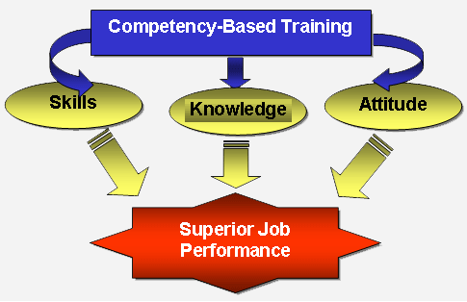

Slide 11
Kolb’s theory of experiential learning cycle
Concrete experience
(values clarification)
Active experimentation
(applying new learning)
Learners
Reflective
observation
(critical thinking)
Abstract
conceptualization
(internalizing new learning/expanding existing learning)

Slide 12
Developing a Course Syllabus
The course syllabus provides a summary of the major components of a course and may be given to individuals requiring information about the course in advance of training.
A syllabus usually contains the following information:
Course description Methods of course evaluation
Course goals Course duration
Participant learning objectives Suggested class size
Description of training methods Course dates
Description of training materials Course organizer
Participant selection criteria

Slide 13
Training Guide: Structure
IRT: Description
IRT: Goal
IRT: Learning Objectives [# 6 as the module]
Module: Description
Module: Goal [1/6 learning objective]
Module: Objectives [# as per units]

Slide 14
Training Guide: …
Unit: Description
Unit: Goal [one of module objective]
Unit: Objective [# as per session]
Session: Topic
Session: objective [one of unit objective]

Slide 15
Training Guide: …
Enabling objectives
Learning Method
Allowed Time
Learning Materials
Learning Activities/Steps [Instruction and content]
Facilitator Note

Slide 16
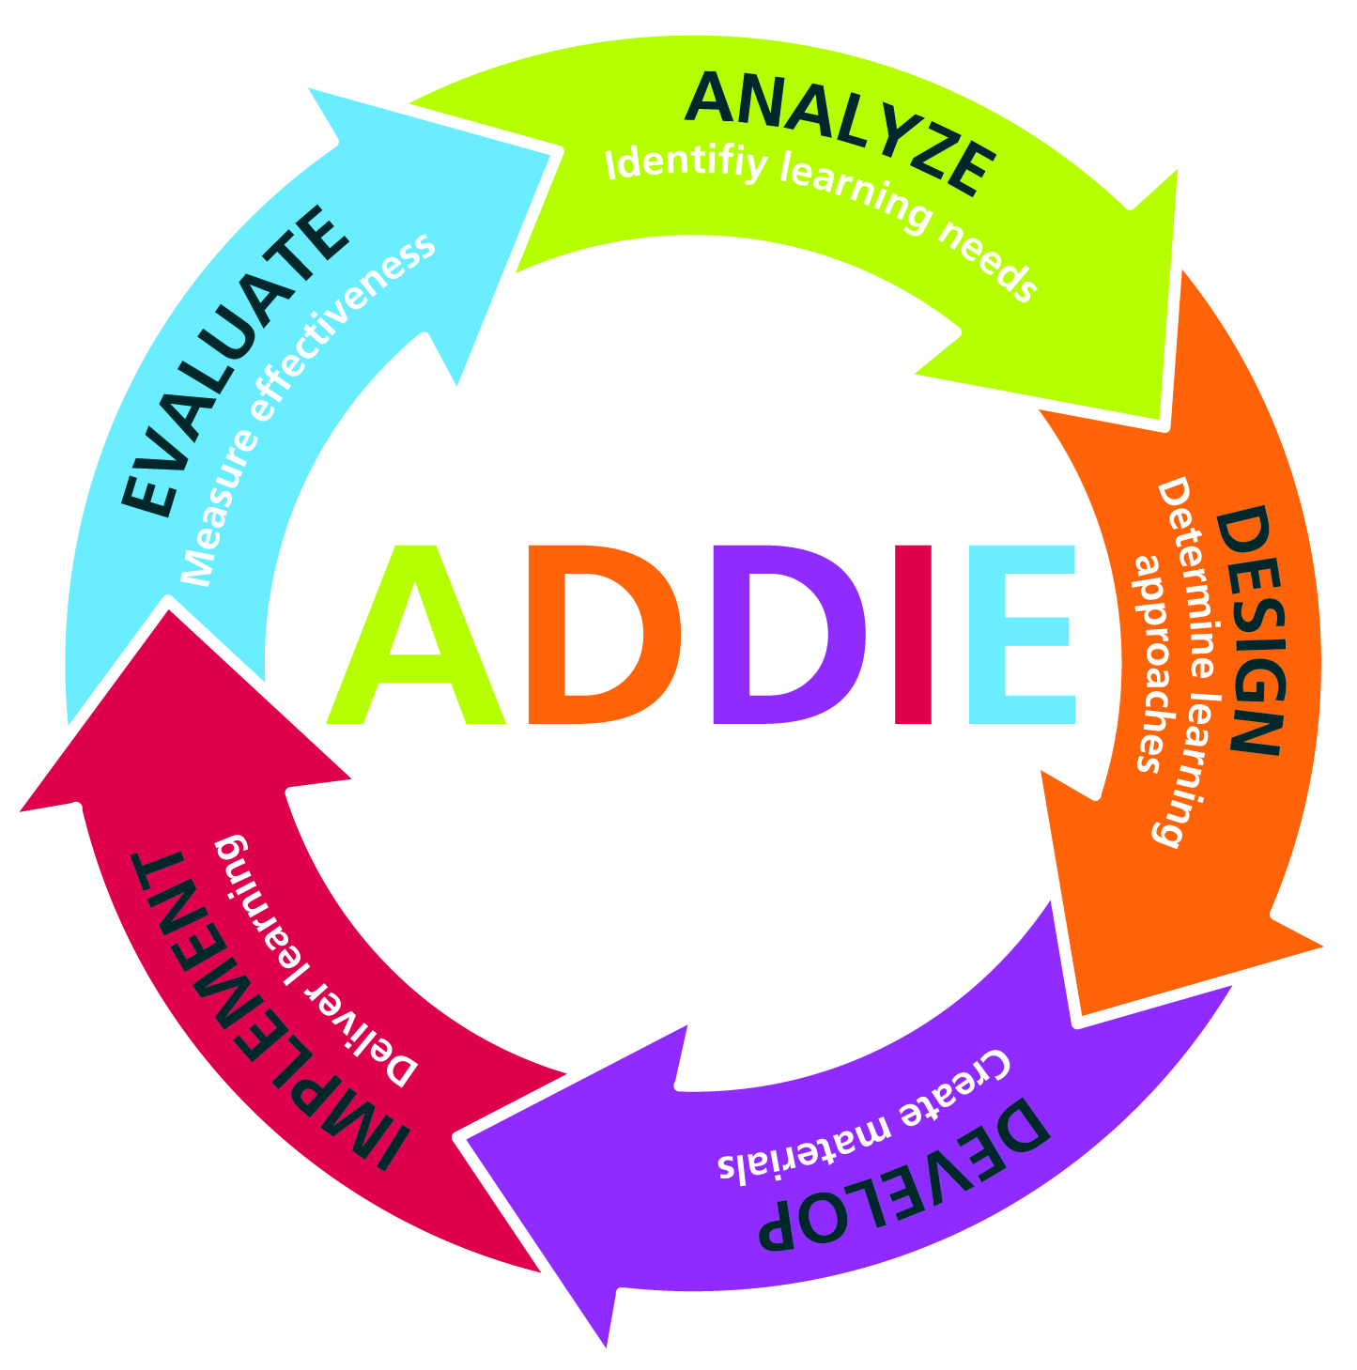

Slide 17
Study finding
A time- motion study shows that they seem to give due priority to family health services (45% of time spent); hygiene and environmental sanitation (30%) and disease prevention and control 12% but only 1% for NCDs
According to FMOH- HEP assessment report NCD performances are very low in terms of screening, HE, and referral

Slide 18
Study finding
According to MTR-2018 and FMOH 18, HEWs are lacking the required competences in terms of “ knowledge” (KPS) and “skill” to provide NCD services based on Level 4 – critical aspects of competences. “ Skill” domain has been very critical

Slide 19
Training modality
Face to Face
Distance
E-learning [online]
Blended

Slide 20
Digital Module Development
Digital module [multimedia]
LEEP project on RMNCAH module using SMS and IVR supplemented with face to face approach by basic phone
SharePlus Korea company on hygiene and environment health using 2D, 3D and video graphic in blended training approach by smart phone

Slide 21
Blended learning
Three main benefits
improved pedagogy
increased access and flexibility
increased cost effectiveness

Slide 22
Digital IRT Module Development
General Objectives:
To ensure the health extension professionals’ knowledge, attitude and skills through periodically updated using appropriate digital technology to enable them provide good quality health care services to the community.

Slide 23
Digital IRT
Specific objectives:
Develop a digital module of integrated refresher training for health extension professional
Test the digital module to its appropriateness and compatibility as a blended training material
Endorse the digital module and scale at the national for the cascading of integrated refresher training across all regions

Slide 24
Concept of eLearning

Slide 25
Thank You

